Slide 1
GPS Navigation
ELEC 7950-001 VLSI DESIGN and TEST Seminar
Presented By: Sourabh Sanghavi

Slide 2
CONTENTS/OVERVIEW
Introduction
Radio Navigation
GPS
Principle of Satellite Navigation
Objective, Policy and Status
System Architecture
GPS Receiver
GPS Measurement Models
Error Sources
Differential GPS
Applications
References

Slide 3
Introduction: Brief History of Navigation
Three important factors that were important for realization of Navigation System
Geodesy – study of shape & size of Earth
Timekeeping – art & science of measuring time
Astronomy – astronautics, science & technology of space flights

Slide 4
Classification of Navigation System
Dead Reckoning: Calculate distance using speed, time and direction
Guidance System: Lighthouse, Radio-beacons, ILS, MLS and Heat Sensors
Position Finding Systems: Determine position of user in well defined Coordinate frame such as GPS

Slide 5
Radio-Navigation
Methods of Radio-Navigations
Trilateration
Hyperbolic Positioning
Doppler Positioning

Slide 6
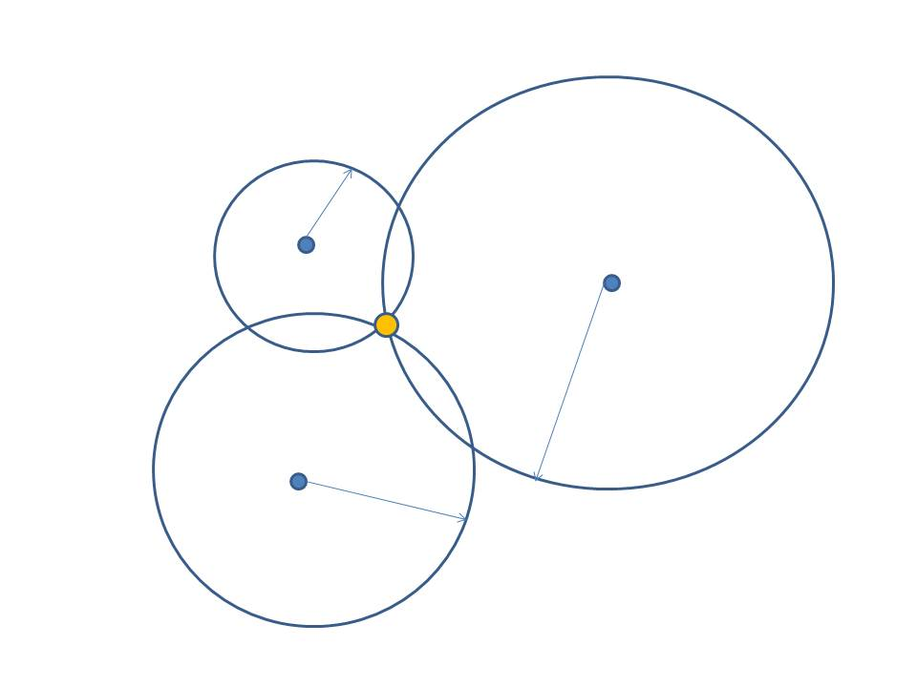
Trilateration
Estimation of position based on measurement of distances is referred to as Trilateration. And radio-navigation system based on this idea is known as Time of Arrival System(TOA). GPS is TOA System.
1
r1
3
P
P’
$\sqrt{{\left(xk−x\right)}^{2}+{\left(yk−y\right)}^{2}}$ = r_{k}
r3
r2
2

Slide 7
Radio Navigation Systems: Terrestrial Systems
Loran: Long range radio and navigation. It consists of master and secondary transmitters typically separated by 1000 km. There are total of 29 station forming 13 chains which cover US Coastal water and Bearing Sea.
OMEGA: First worldwide continuously available radio-navigation system. System became operational in 1970s and decommissioned in 1997.

Slide 8
Radio Navigation Systems: Satellite Navigation Systems
TRANSIT: Navy Navigation Satellite System
Concept developed in 1958, experimental satellites launched in 1961- 62, became operational in 1964. 11 Satellites in total (low- altitude 1100 km)
Continuously records Doppler shift of the received signal and Navigation message for over 10-20 minutes of satellite pass.
Doppler Count = $\int_{ti−1}^{ti}{\left(fT−fR\right)dt}$

Slide 9
GPS
Active & Passive
Positioning Method: Doppler, Hyperbolic or Trilateration
Pulsed versus Continuous Wave
Carrier Frequency: L- Band (1Ghz-2Ghz)
Satellite Constellation and Orbits LEO, MEO or GEO

Slide 10
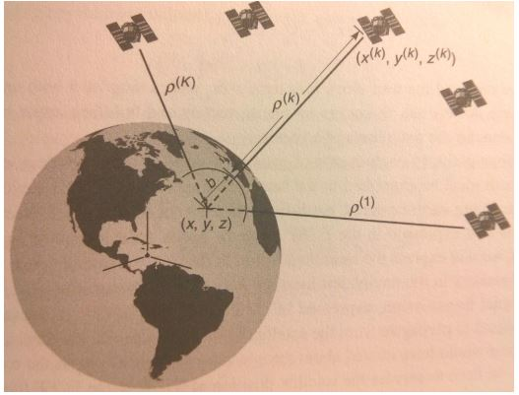
Principle of Satellite Navigation
$ρ$^{k} : Pseudo-ranges (measurements)
(x^{k}, y^{k}, z^{k}) : Satellite position (known)
$ρ$^{k} $= \sqrt{{\left(xk−x\right)}^{2}+{\left(yk−y\right)}^{2}+{\left(zk−z\right)}^{2}}$ - b

Slide 11
Performance Summary of Radio Navigation Systems
Other Navigation Systems :- Russia: GLONASS
Europe: Galileo
China: BeiDou Japan: Quasi-Zenith Satellite System India: IRNSS

Slide 12
Objectives, Policies and Status
Objective of GPS: Provide US Military with accurate estimates of position, velocity and time.
Policy: Standard Positioning Service (SPS)
Precise Positioning Service (PPS)
Status: Going stronger than ever before.

Slide 13
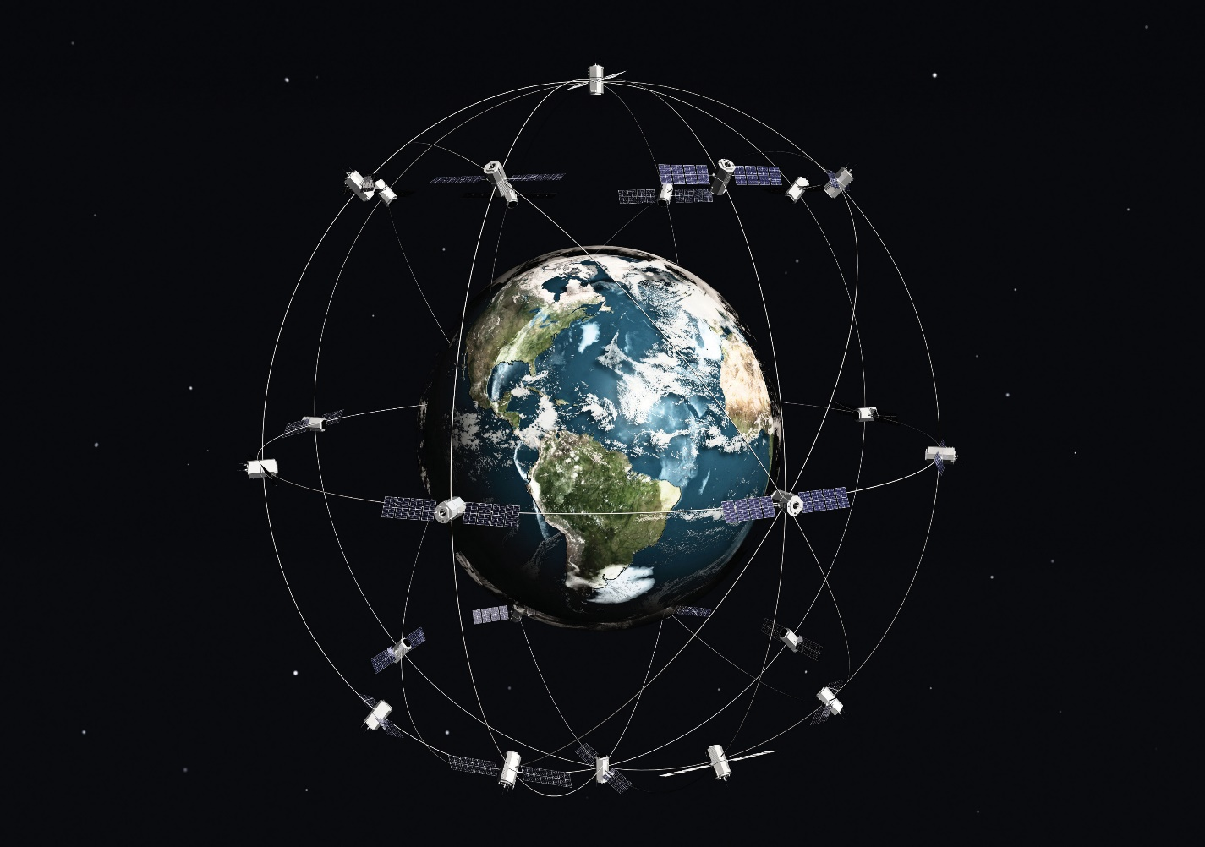
SYSTEM ARCHITECTURE
SPACE-SEGMENT
Orbital Planes: 6, inclined at an angle of 55º relative to each other
Orbital Radius: 26,560 km
Orbital Period: 12 Hours
In total 24 working Satellites
all the time.

Slide 14
Control Segment
Master Control Station(MCS): located at Schriever (falcon) Air Force Base near Colorado Springs, Colorado.
to monitor maintain and satellite orbits, satellite health,
to maintain GPS time,
to predict satellite ephemerides,
to update satellite navigation message,
to command small maneuvers of satellites to maintain orbit, and relocation to compensate for failure if needed.
Monitoring Stations: US Air Force bases spread around the globe, Hawaii, Colorado Springs, Cape Canaveral, Ascension Island, Diego Garcia, and Kwajalein. There are 11 more monitoring stations added afterwards operated by National Geospatial Agency (NGA) and DoD.

Slide 15
Elements of GPS Control Segment

Slide 16
Signals
GPS satellites uses 2 L-band frequencies, Link 1 (L1) and Link 2 (L2).
L1: f_{l1} = 1575.42 MHz (Civil and DoD users)
L2: f_{l2} = 1227.60 MHz (Only DoD)
Additionally there are 2 more L3 and L4 which are associated with classified payloads,
L3 for Nuclear Detonation Detection System (NDS) and
L4 for Reserve Auxiliary Package (RAP)

Slide 17
Signal Structure
Consists of 3 components:-
Carrier: RF Sinusoidal signal with frequency f_{l1} and f_{l2}
Ranging Code: Associated with each service (i.e., SPS & PPS) is a family of Binary Code called as pseudo-random noise (PRN sequence).
SPS codes : C/A-codes
PPS code : Precision codes or P(y) codes
Navigation Data: A binary coded message consisting of data on satellite health status, ephemeris(satellite position and velocity), clock bias parameters, and an almanac data.

Slide 18
Ranging Code
C/A – code
Unique sequence of 1023 bits called chips for every satellite
Repeated every 1 millisecond
Duration of each C/A code is 1$μs$
Chip width or wavelength is 300m
Rate of C/A code chips or chipping rate is 1.023 MHz
P(y) – code
Unique segment of 10¹⁴ chips
Chipping rate is 10.23 Mcps, ten times that of C/A code

Slide 19
Navigation Data
Transmitted at 50 bits per second
Bit duration 20 seconds
Total time to receive entire message is 12.5 minutes
Essential satellite ephemeris and clock parameters are repeated every 30 seconds.
3 components (i.e., carrier, code and data) are derived coherently from atomic standard aboard satellite whose frequency is 10.23 MHz, t77hus relationship with chipping rate is,
fl1 = 1575.42 MHz = 2 x 77 x 10.23 MHz
fl2 = 1227.60 MHz = 2 x 60 x 10.23 MHz

Slide 20
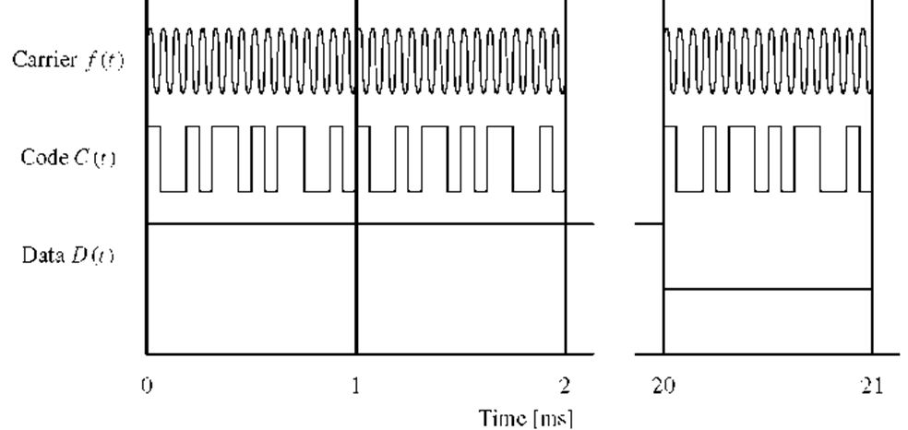
Satellite signal: [D(t) $⊕$ C(t)] $⊗$ f(t)
L1 and L2 signal leaving k^{th} satellite can be modeled as:-
L1 = $s_{L1}^{k}$(t) = $\sqrt{2PC1}$ x^{(k)}(t)D^{(k)}(t)cos(2$πfL1t+θL1$) + $\sqrt{2PY1}$ y^{(k)}(t)D^{(k)}(t)sin(2$πfL1t+θL1$)
L2 = $s_{L2}^{k}$(t) = $\sqrt{2PY2}$ y^{(k)}(t)D^{(k)}(t)sin(2$πfL2t+θL2$)

Slide 21
GPS Receivers
Functions of GPS receivers are:-
Capture RF signals transmitted by satellites
To separate the signals from satellite in view
To perform measurement of signal transit time and Doppler shift
Decode navigation message to determine satellite position, velocity and clock parameters
To estimate user position, velocity and time

Slide 22
Signal Acquisition and Tracking

Slide 23
Estimation of Position, Velocity and Time
Quality of PVT estimates depend on 2 things:-
Number of satellite in view and their spatial distribution in sky and
Quality of range and range rate measurements
Revised model of Pseudo-range measurement:-
$ρ$^{k} $= \sqrt{{\left(xk−x\right)}^{2}+{\left(yk−y\right)}^{2}+{\left(zk−z\right)}^{2}}$ + b + $ε$^{(k)} , ignoring $ε$^{(k)} and solving equation
to obtain x, y, z & b which fits measurement best in some sense
Least Square Algorithm to obtain best fit, converts estimation problem into minimization problem,
$$\sum_{k=1}^{K}{\text{(}\sqrt{{\left(xk−x\right)}^{2}+{\left(yk−y^{2}\right)}^{2}+{\left(zk−z\right)}^{2}} \text{+ }\text{b}\text{ − }ρ\text{k}\text{ )}\text{2} }$$

Slide 24
GPS Measurements Models
Code Phase Measurements
t = GPS Time (GPS monitor station)
$τ$: transit time
t^{s} (t - $τ$): emission time
t_{u} (t): arrival time measured at user receiver clock
therefore pseudo-range, $ρ$(t) = c [t_{u} (t) – t^{s} (t - $τ$)] and in terms of GPST
t_{u} (t) = t + $δ$ t_{u} (t) and t^{s} (t - $τ$) = (t - $τ$) + $δ$t^{s} (t - $τ$),
thus above pseudo - range can be written as,
$ρ$(t) = c[t + $δ$ t_{u} (t) – ((t - $τ$) + $δ$t^{s} (t - $τ$)) ] + $ερ$(t) and,
c $τ$ = r(t, t- $τ$) + I$ρ$(t) + T$ρ$(t)
r(t, t- $τ$): True Range, I$ρ$(t) and T$ρ$(t) are Ionospheric & Tropospheric delays

Slide 25
Carrier Phase Measurement
Count of number of cycle received since starting point of interval
$∅$(t) = $∅(t0)$ + $\int_{t0}^{t}{f(s)}ds$, for small (t - t₀), f = f₀, thus $∅$(t) = $∅(t0)$ + f₀(t – t₀)
In case of GPS, $∅$(t) = $∅u(t)$ + $∅s(t −τ)$ + N,
$∅$(t) = (r(t, t - $τ$)/$λ$) + N
$∅$ = $λ$⁻¹ [r + I $∅$(t) + T$∅$(t) ] + c/ $λ$ ($δ$t_{u} - $δ$t^{s}) + N + $ε∅$

Slide 26
Error Sources
Satellite clock : 2 meters
Upper atmosphere(Ionosphere) : 2 – 10 meters
Receiver clock : 1 meters
Satellite Orbit : 2 meters
Lower atmosphere(Troposphere) : 2 – 2.5 meters
Multipath : Code (0.5 - 1 m), Carrier (0.5 – 1 cm)
Receiver Noise : 0.25 - 0.5 meters

Slide 27
Differential GPS and Relative Positioning

Slide 28
Applications
Agriculture
Aviation
Environment
Marine
Public Safety & Disaster
Recreation
Roads & Highways
Space
Surveying & Mapping
Timing

Slide 29
QUESTIONS ?

Slide 30
References
Global Positioning System by Pratap Misra and Per Enge
IS – GPS – 200D, GPS Interface Specification
Getting, Ivan A (1993) The Global Positioning System, IEEE Spectrum, vol. 30, no. 12, pp 36-47
Avila Rodriguez, J., M. Irsigler, G. Hein and T. Pany (2004), Combined GALILEO/ GPS frequency and signal performance analysis
SPS (2001), GPS Standard Positioning Service Signal Specification, U.S. Department of Defense
http://www.navcen.uscg.gov/?pageName=gpsEphemerisInfo
http://cddis.nasa.gov/Data_and_Derived_Products/GNSS/broadcast_ephemeris_data.html

